Slide 1
Discussion items – Oct-20th^{th}
Scaling laws with p-values
Chemostasis (c-q relationship)
Catchment controls on solute transport
https://www.sciencedirect.com/science/article/pii/S030917081500233X
Analogy: SpeciesRichness-ExtrinsicFeatures
PCA analysis

Slide 2
Scaling laws with p-values
Scaling laws for WHONDRS data
Scaling laws for StreamStats data
Scaling laws for HYDROSHEDS data
Scaling laws for EPA-Waters-Catchment data
Scaling laws for EPA-Waters-Watershed data
Scaling laws are in the form → Species richness = b*(DataFeature)^{z}
P-value in the legend

Slide 3
Scaling laws: SR vs WHONDRS
Scaling laws are in the form → Species richness = b*(DataFeature)^{z}
Data features include
SW_Temp_degC -- Water temperature at 50% depth at downstream sampling location
DO_mg.per.L -- Dissolved oxygen at 50% depth at downstream sampling location
DO_perc.sat -- Dissolved oxygen at 50% depth at downstream sampling location
SW_pH -- pH value from colorimetric pH strip
Avg water column height
DS_Water.Column.Height_cm -- Height of water column at downstream sampling location
MS_Water.Column.Height_cm -- Height of water column at midstream sampling location
US_Water.Column.Height_cm -- Height of water column at upstream sampling location

Slide 4
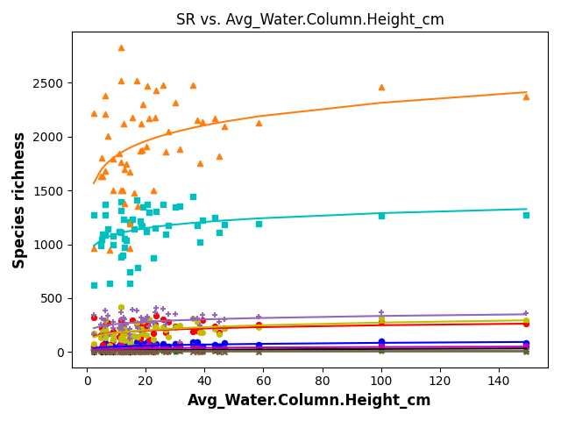
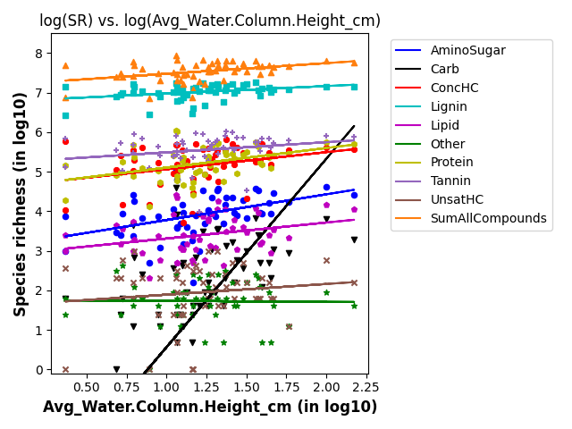
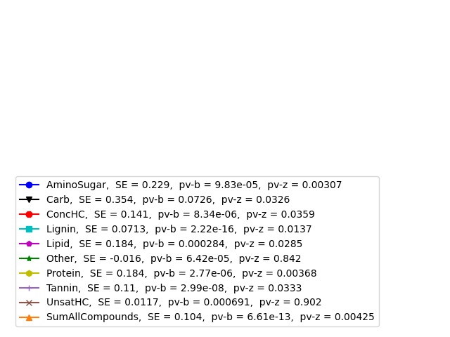
SR vs avg water column height
P-value > 0.05
Other
UnsatHC

Slide 5
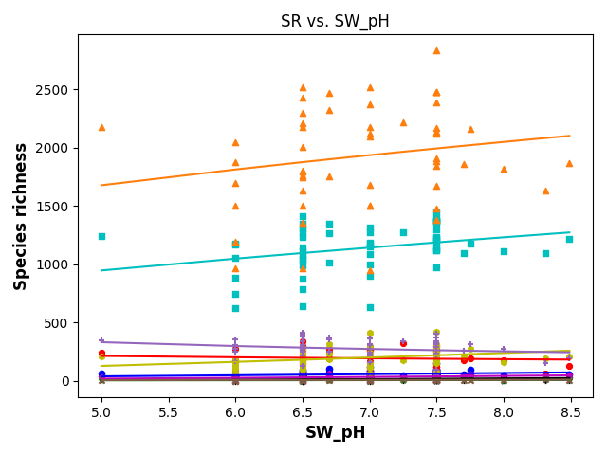
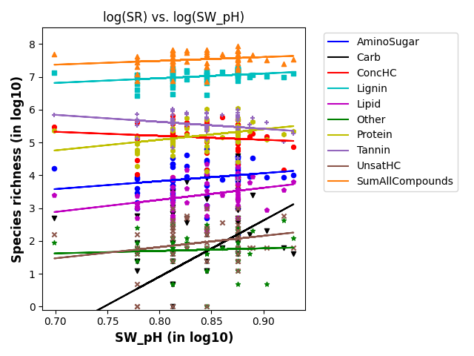
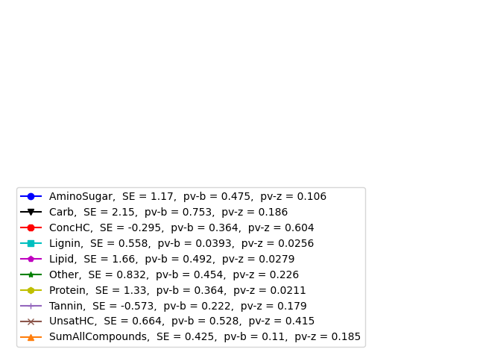
SR vs SW_pH
P-value > 0.05
AminoSugar
Carb
ConcHC
Other
Tannin
UnsatHC
SumAllCompounds

Slide 6
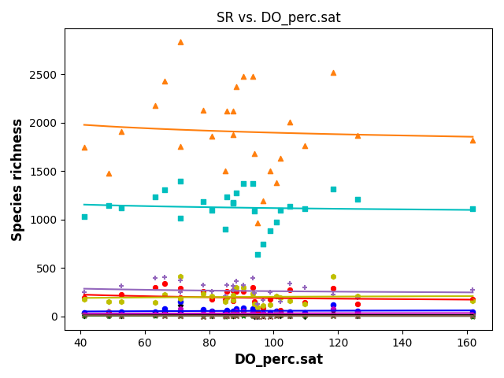
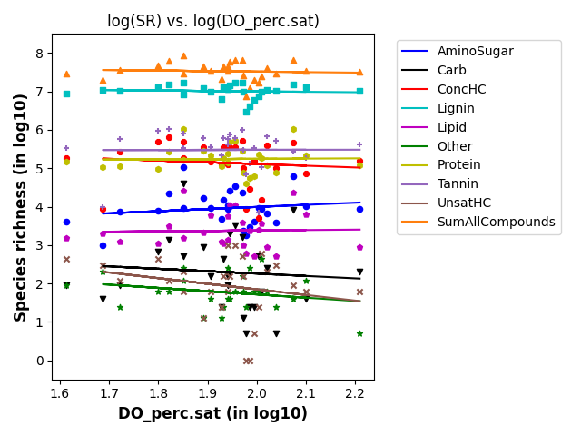
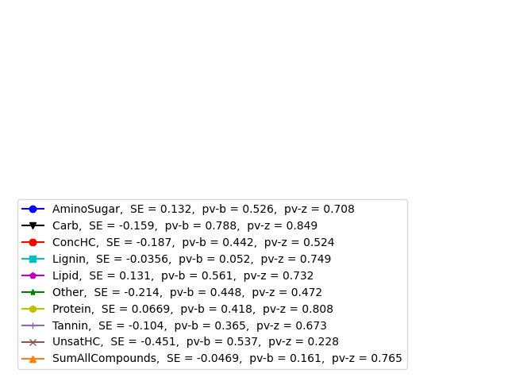
SR vs DO_per.sat
P-value > 0.05
Almost all

Slide 7
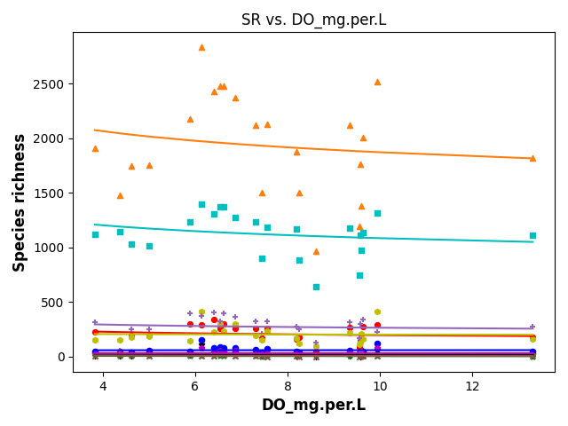
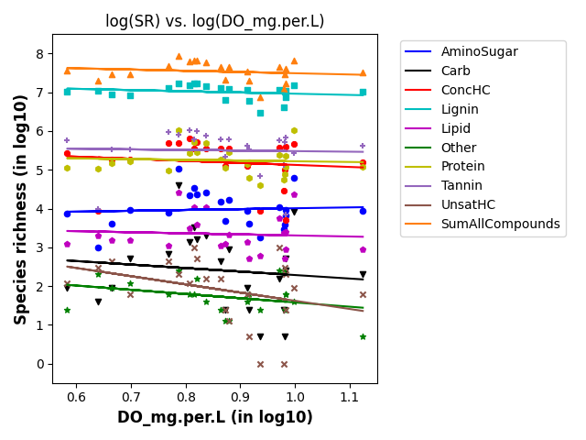
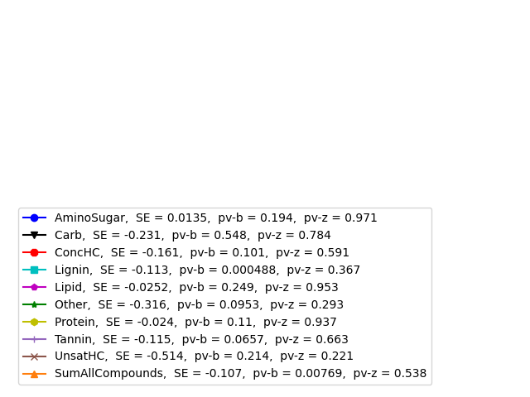
SR vs DO_mg.per.L
P-value > 0.05
Almost all

Slide 8
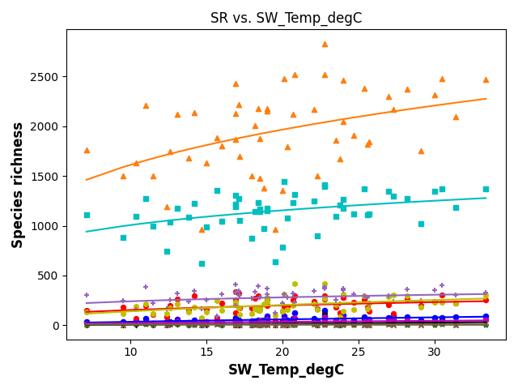
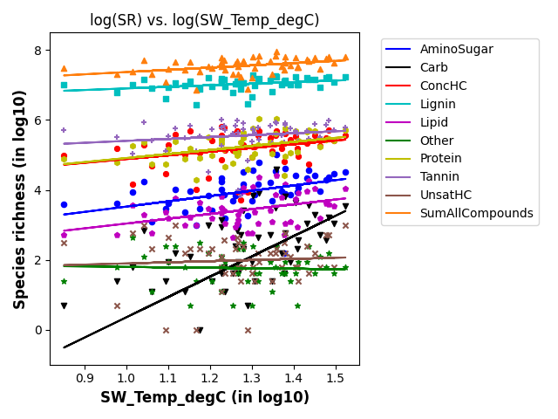
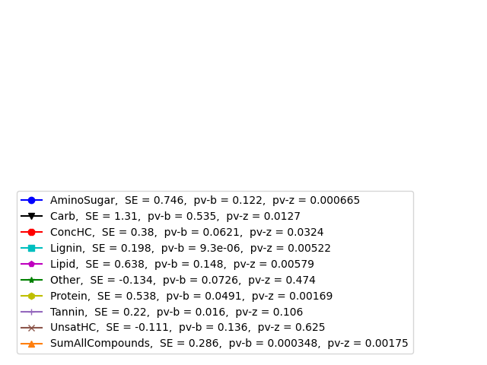
SR vs SW_Temp
P-value > 0.05
Other
Tanin
UnsatHC

Slide 9
Scaling laws: SR vs StreamStats
Scaling laws are in the form → Species richness = b*(DataFeature)^{z}
Data features include
Latitude – Radiation is an important
Drainage area
Precipitation
Forest cover

Slide 10
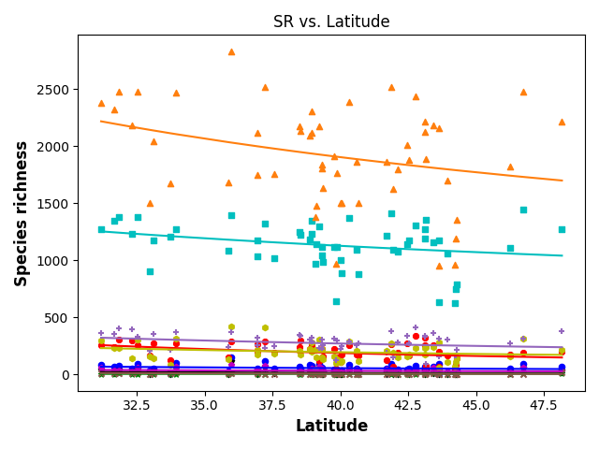
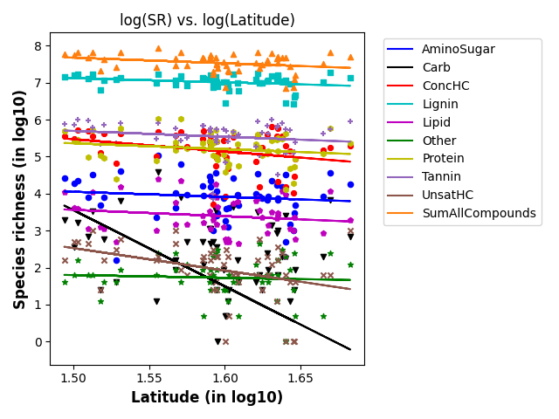
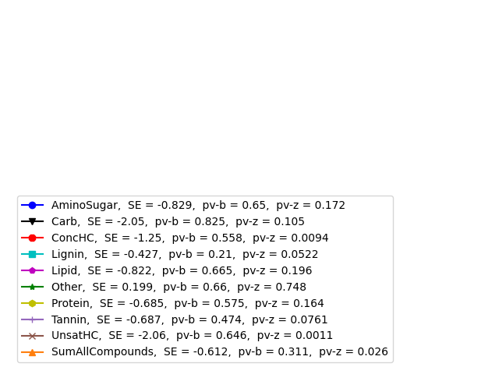
SR vs latitude

Slide 11
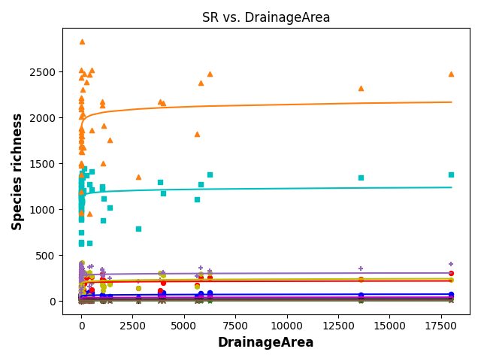
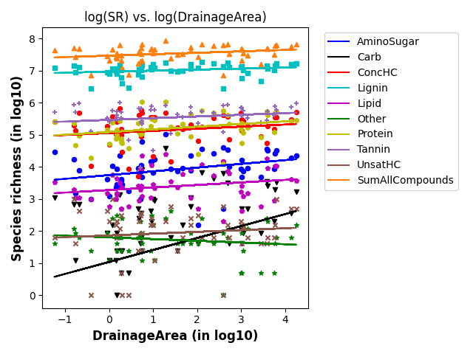
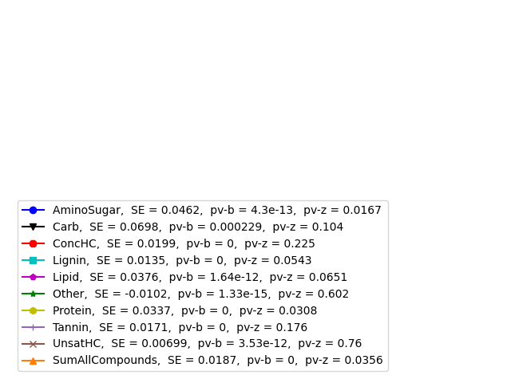
SR vs drainage area

Slide 12
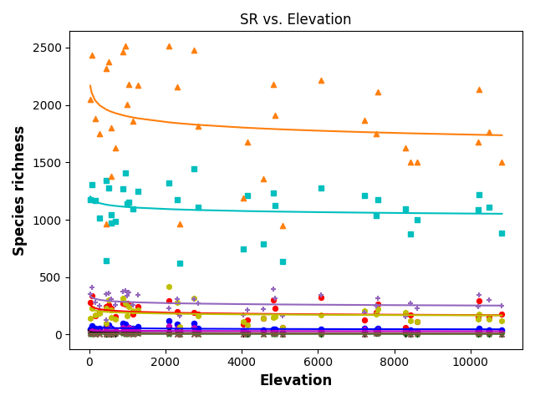
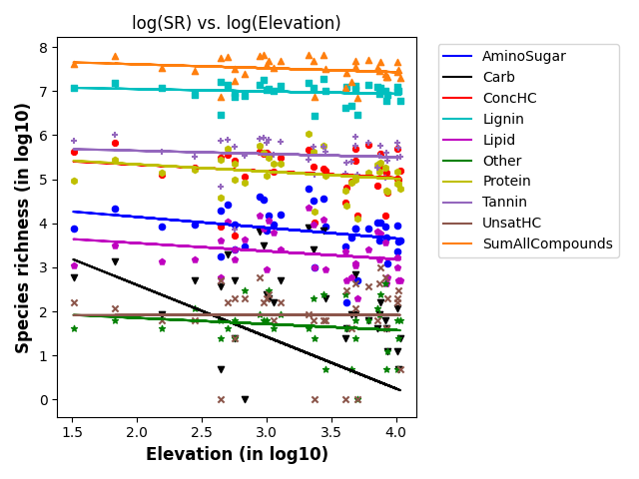
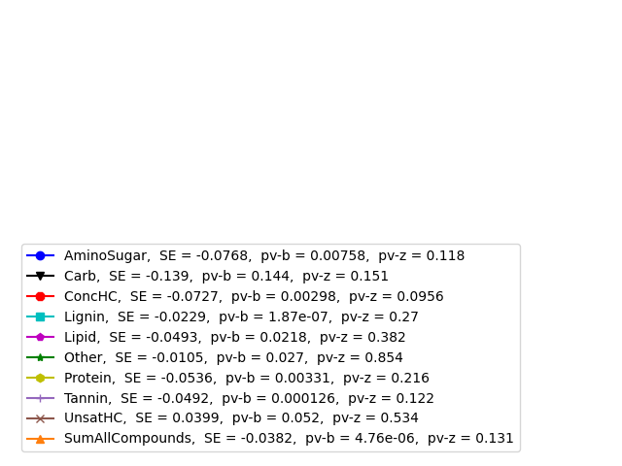
SR vs elevation
Notes:
As the elevation increases, temperature changes and stream order changes, resulting in sampling new biomes and lesser number of compounds

Slide 13
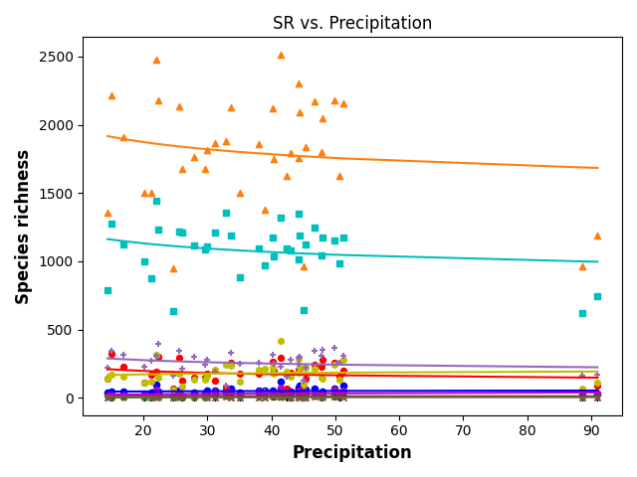
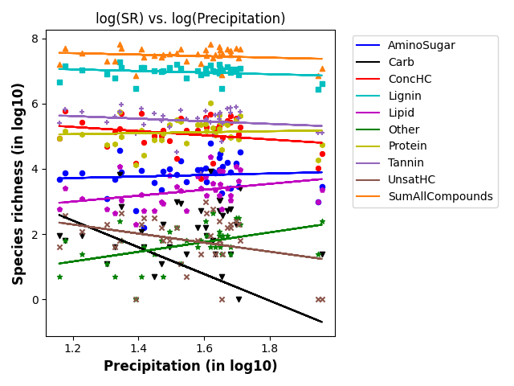
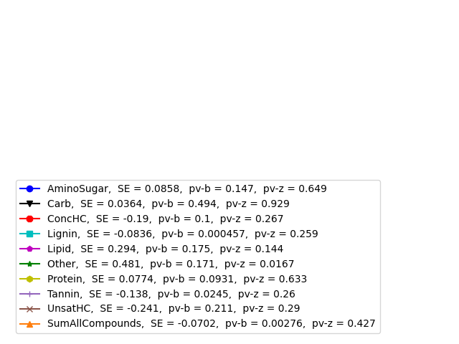
SR vs precipitation

Slide 14
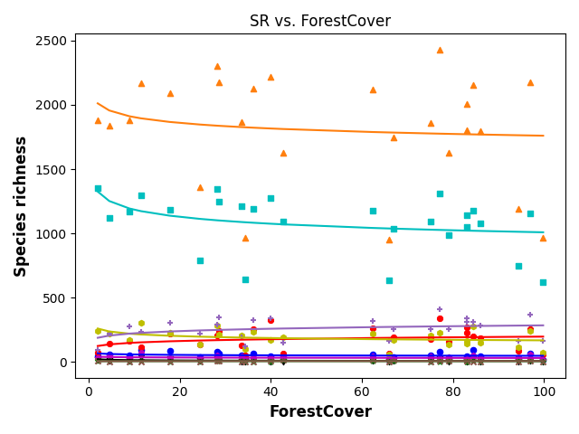
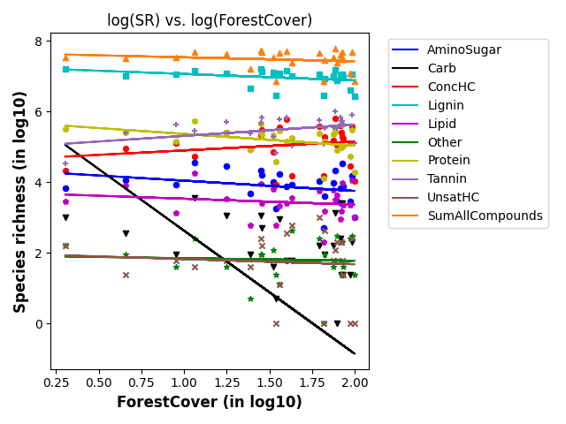
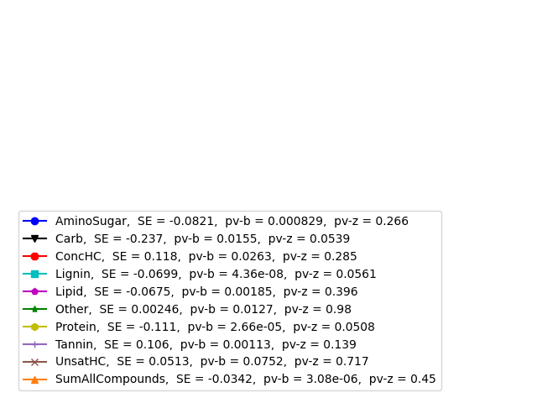
SR vs forest cover
Notes:
Forest cover is related to elevation – Forest cover and forest litter types → Increasing?
If you have higher forest cover, we have lesser

Slide 15
Scaling laws: SR vs HYDROSHEDS
Scaling laws are in the form → Species richness = b*(DataFeature)^{z}
Data features include
Actual ET – can be related to pH and DO
Potential ET – can be related to pH and DO
Air temperature – can be related to pH and DO
Natural discharge -- can be related to pH and DO

Slide 16
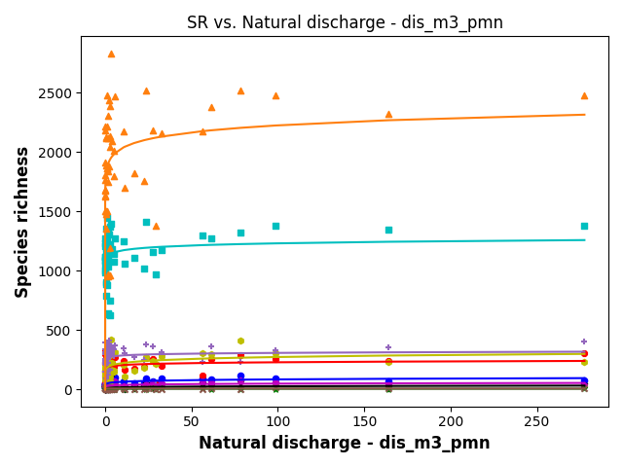
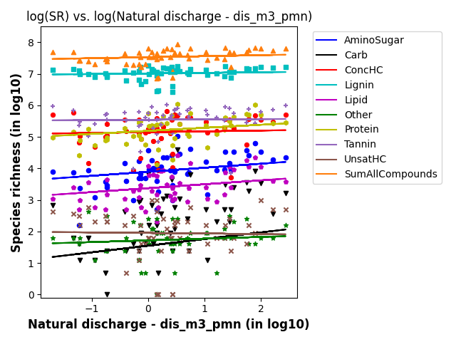
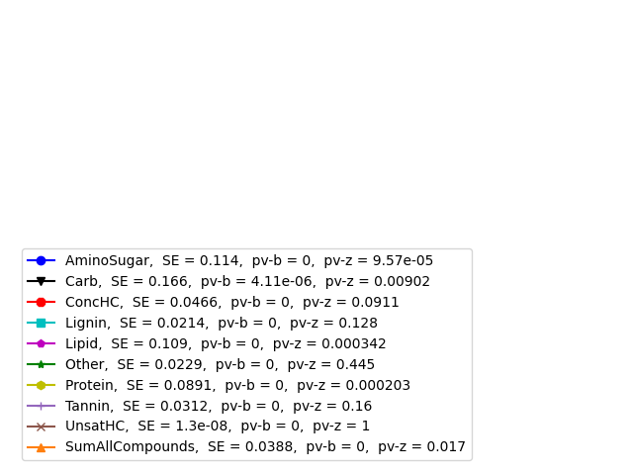
SR vs discharge
Notes:
Chemostatic/Chemostatis behavior quantification
Nandita basu? Canada
Researcher in Idaho? Sarah Godsey (2000)

Slide 17
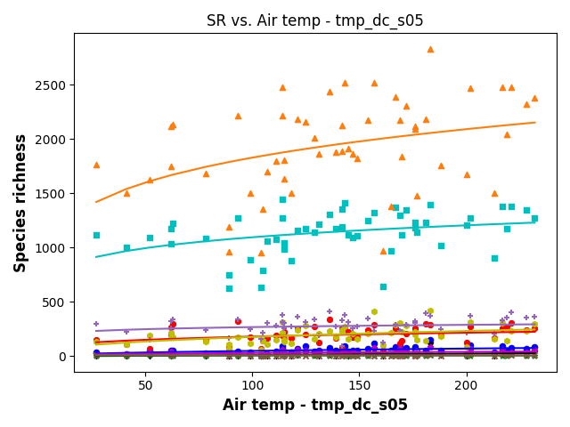
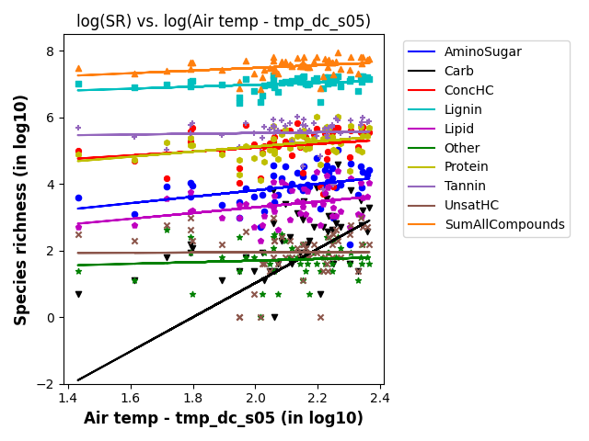
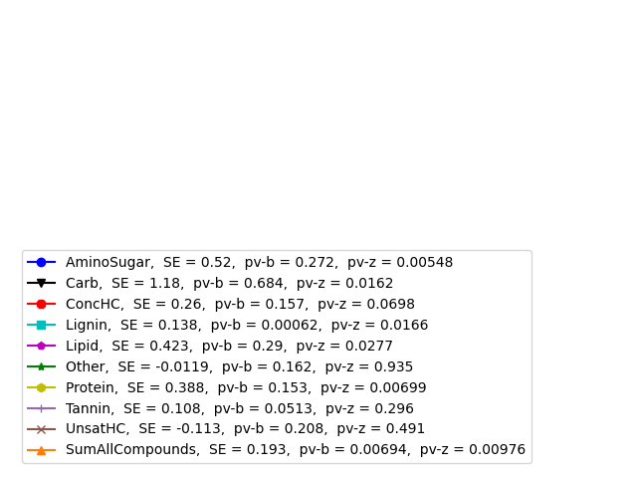
SR vs air temperature

Slide 18
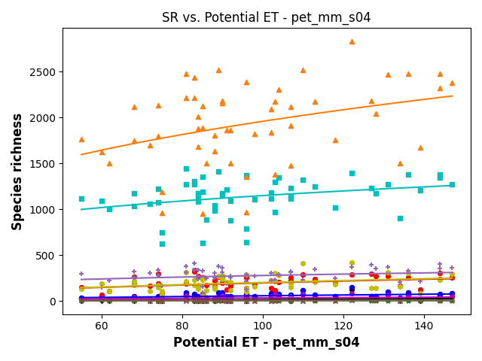
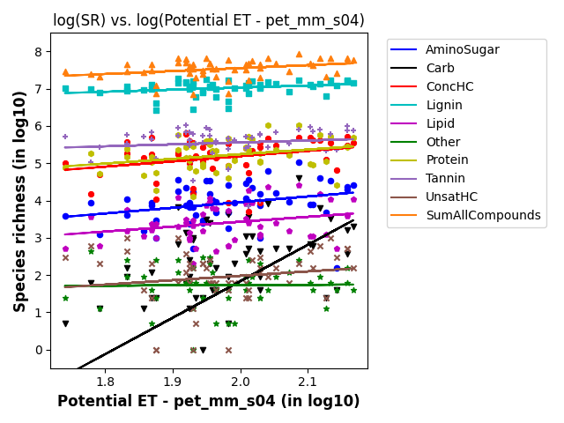
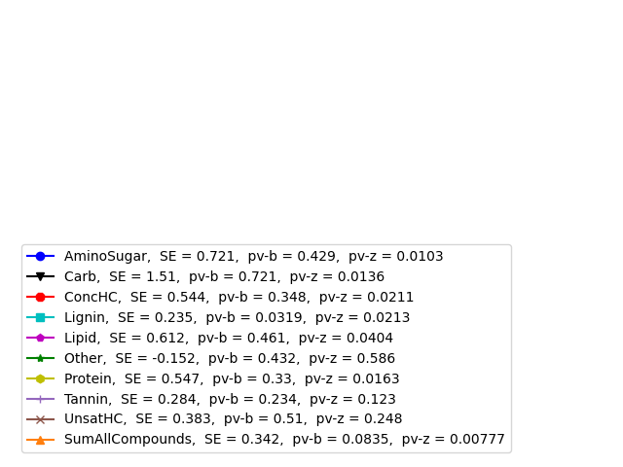
SR vs potential ET

Slide 19
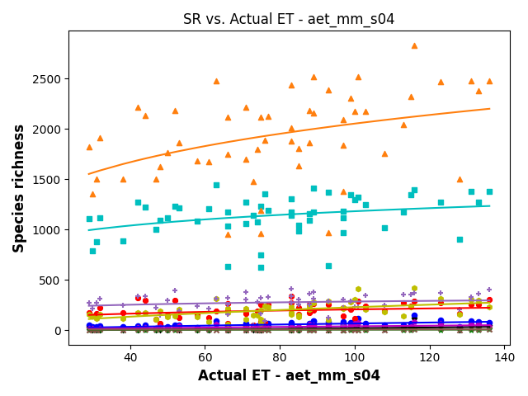
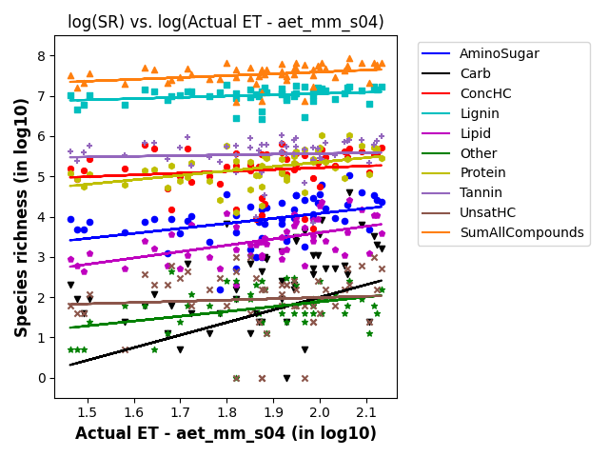
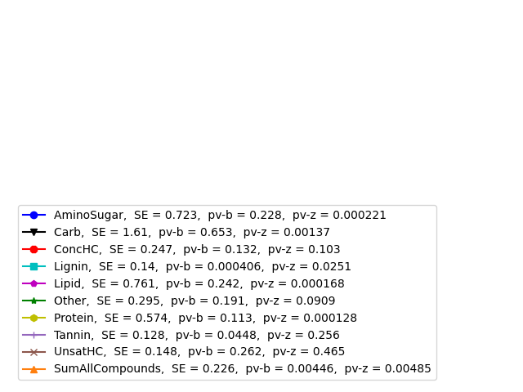
SR vs actual ET

Slide 20
Scaling laws: SR vs EPAWaters-Catchment
Scaling laws are in the form → Species richness = b*(DataFeature)^{z}
Data features include
Stream temperature (summer, annual) – Local avg
PctNonAgIntrodManagVegCat
% Nonagriculture nonnative introduced or managed vegetation landcover type reclassed from LANDFIRE Existing Vegetation Type (EVT), within catchment
Precipitation gradient

Slide 21
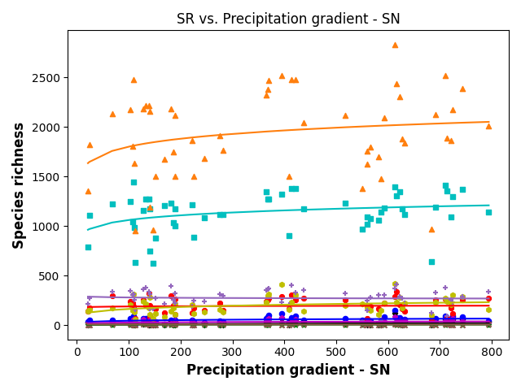
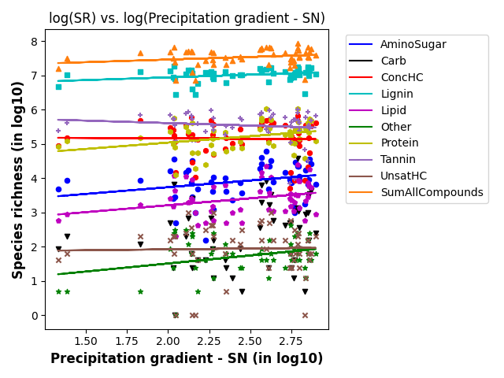
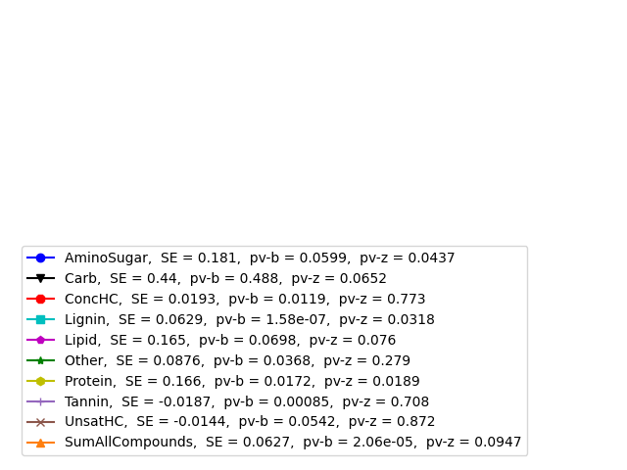
SR vs precipitation gradient

Slide 22
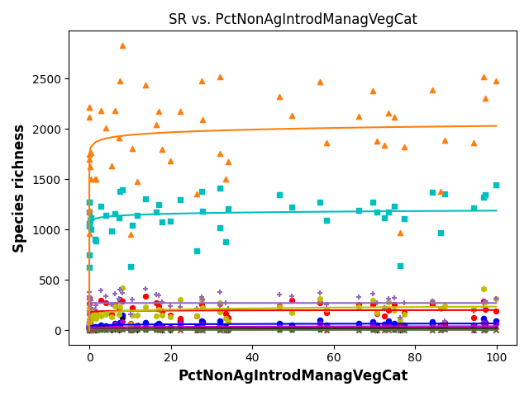
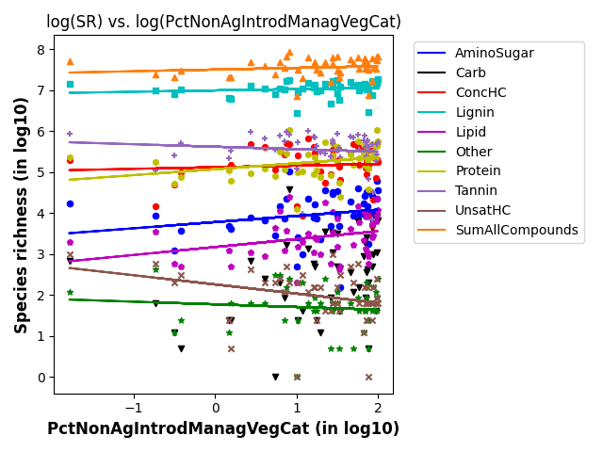
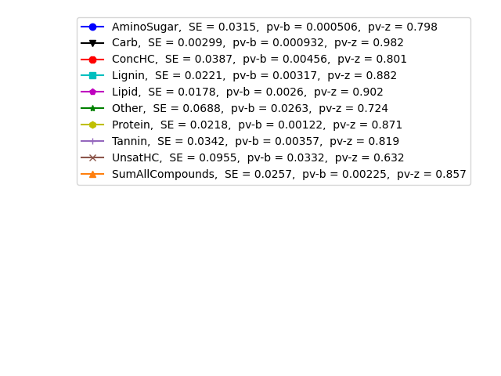
SR vs PctNonAgIntrodManagVegCat

Slide 23
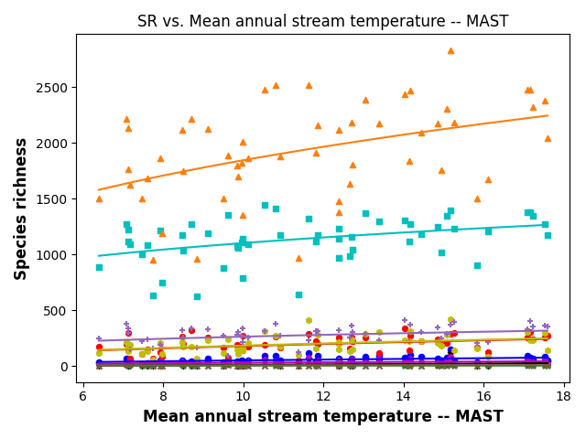
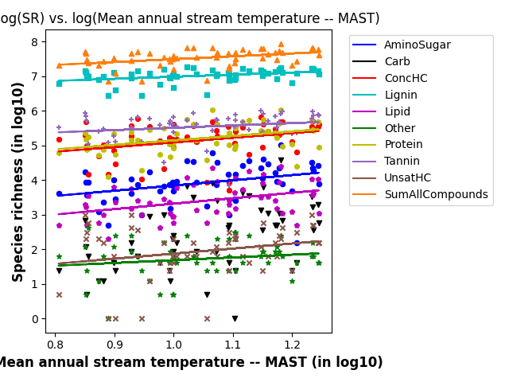

SR vs Mean annual stream temperature

Slide 24



SR vs Mean summer stream temperature

Slide 25
Scaling laws: SR vs EPAWaters-Watersheds
Scaling laws are in the form → Species richness = b*(DataFeature)^{z}
Data features include
PcTUrbLo, PctUrbMd, and PctUrbHi
% of watershed area classified as developed, low/med/high-intensity land use

Slide 26



SR vs PctUrbLoWs

Slide 27



SR vs PctUrbMdWs

Slide 28



SR vs PctUrbOpWs

Slide 29


Chemostasis plots
Chemostasis (c-q relationship)
Catchment controls on solute transport (Musolff et al)
https://www.sciencedirect.com/science/article/pii/S030917081500233X
Analogy: SpeciesRichness-ExtrinsicFeatures
WHONDRS
StreamStats
HYDROSHEDS
EPA-Waters-Catchment
EPA-Waters-Watershed

Slide 30


Z-CV (WHONDRS)

Slide 31

Z-CV (StreamStats)

Slide 32

Z-CV (HydroSheds)

Slide 33

Z-CV (EPA-W-Catchment)

Slide 34

Z-CV (EPA-W-Watershed)

Slide 35

Z-CV (All datasets – WHONDRS, StreamStats, HydroSheds, EPA-W-Catchment, EPA-W-Watersheds)

Slide 36

PCA analysis

